Slide 1
Team Fütsies
Alevtina Brown
Matt Britt
Tim Forrester
Carl Ott
Joseph Palacio
Brooks Przybylek

Slide 2
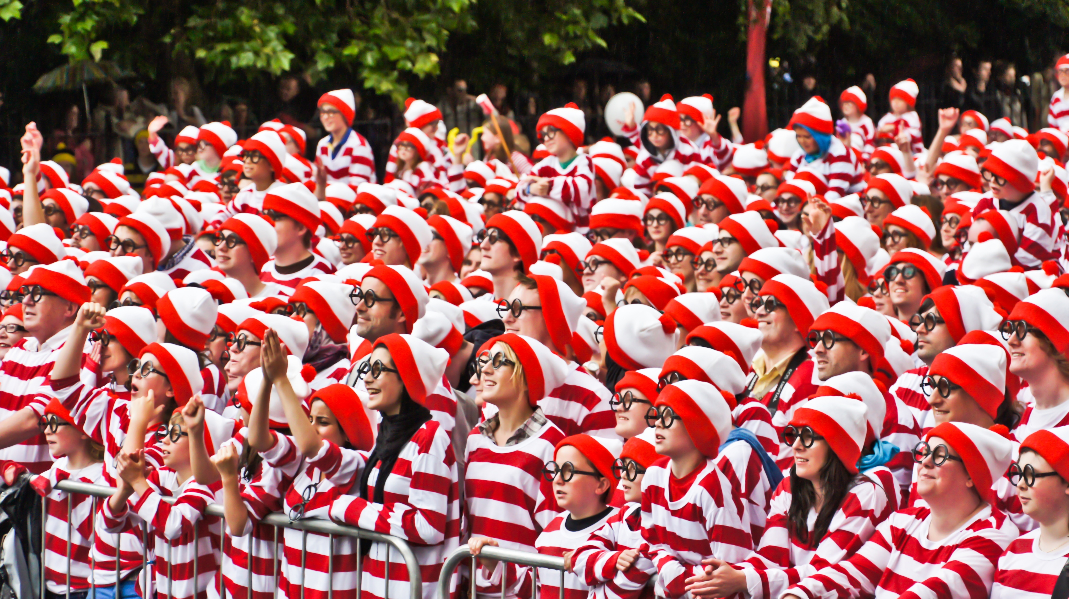
Problem Statement
Difficult to understand traffic flow and crowd sentiment
Design physical spaces to maximize profit and customer satisfaction

Slide 3
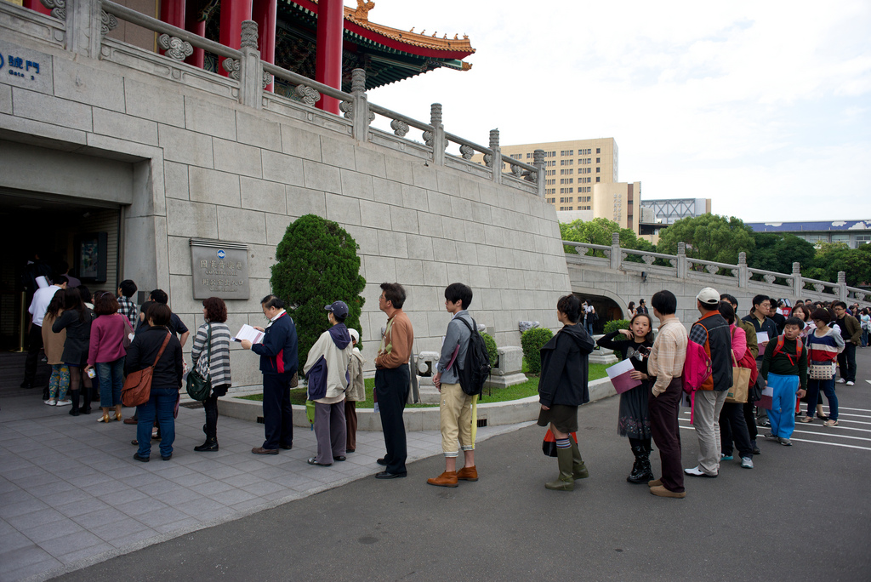
Use Cases
Amusement Park Ride Queue Management
Maximize revenues
Crowd Sentiment
Transitions to Other Rides
Office Space Layout
Fairs
Exhibitions
Movie Theaters
Retail Foot Traffic

Slide 4
Our Solution
Foot Traffic Flow Sensor with Sentiment Analysis
LiDAR in Choke Points
Video Camera with Neural Network Analysis
Capture Traffic and Generate Virtualized AVDs to feed models
Eg: Enable “Roller Coaster Tycoon” Simulators to optimize park layout and traffic flow

Slide 5
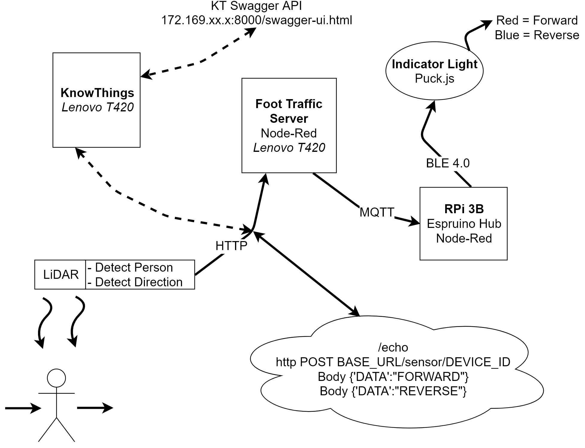
Implementation

Slide 6
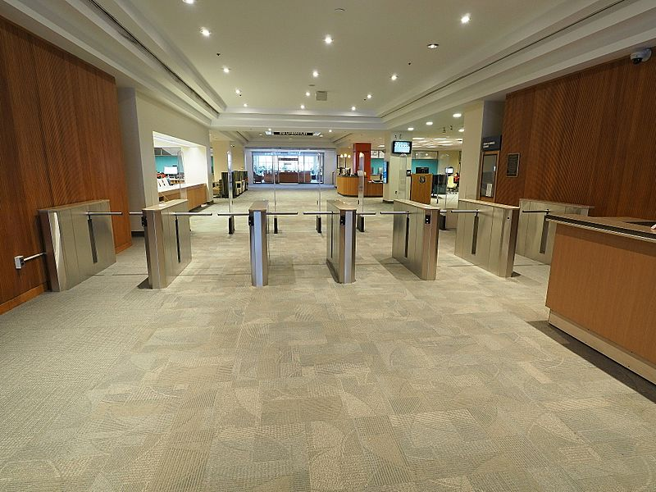
Product Demo
Show Variants
Raspberry Pi
Arduino on ESP8266
Dashboard Status
Indicator Lights

Slide 7
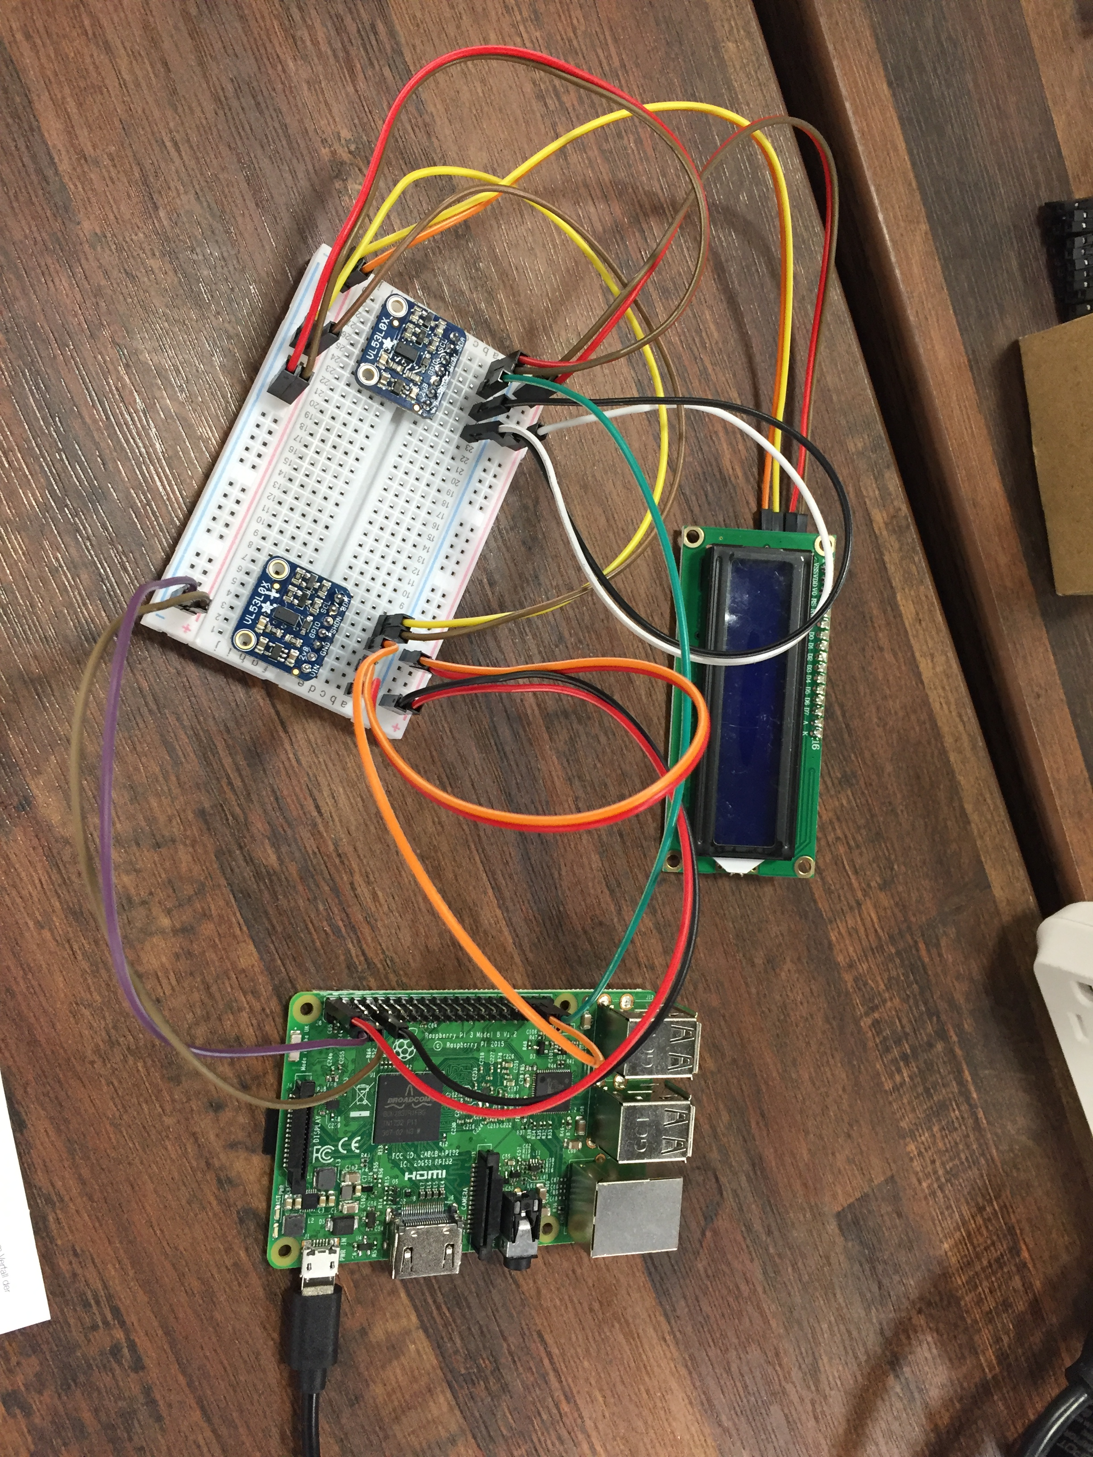
About the Technology
New Team
Started from Scratch
I²C -> HTTP -> MQTT -> Node Red

Slide 8
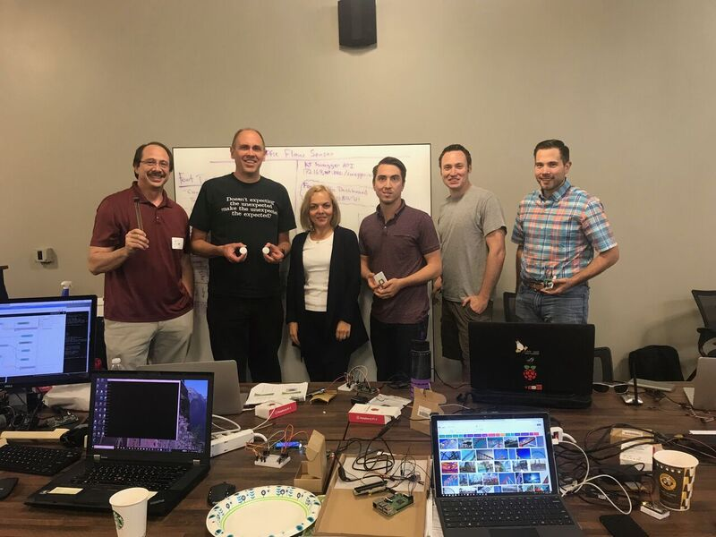
Team Fütsies

